Slide 1
Data Support Contract Update
RHPWG Coordination and Glidepath Subcommittee Call
February 13, 2020
Joe Adlhoch
Emily Vanden Hoek
Air Resource Specialists

Slide 2
Current Tasks
Task 1 – Review and compare data sets on the TSS v2
Review and compare the IMPROVE data set delivered in December 2019 to graphical and data summary products on the TSSv2 for accuracy and completeness. (Task 1 complete – no issues found)
Task 2 – Review and document changes between October 2019 and December 2019 IMPROVE data sets
Review and document the changes for all WRAP sites for:
annual averages (2000-2018)
most recent 5-year averages (2014-2018)
daily data for 2014 and 2016
natural conditions
Task 3 – Data substitutions for 2018
Perform data substitution for four (4) sites to complete 2018 data set
Task 4 – QA check on titling, etc. for TSS graphics
ARS performed a preliminary QA check on titling and other things related to TSS v2 graphics in early 2019. ARS is working with WRAP and CIRA staff to address necessary edits (Task 4 to be completed in conjunction with previously provided edits from stakeholders)

Slide 3
Most Impaired Days:
Annual Differences (2000-2018)
These are the sites/years that show differences in extinction greater than +/- 1 Mm-1 or +/- 0.3 dv
The maximum change is +0.83 dv at MONT in 2018 due to patching allowing some additional high carbon (presumably fire) days into the data set

Slide 4
Most Impaired Days:
5-Year Average Differences (2014-2018)
The maximum change in the 5-year average for MONT1 is about +0.44 dv
The 5-year average Bext for MONT1 increased from 26.76 Mm-1 to 28.09 Mm-1

Slide 5
Most Impaired Days:
Sites with No Change to 5-year Average
AK | DENA1 | CA | DOME1 | MT | FOPE1 | OR | CORI1
 | TRCR1 |  | FRES1 |  | GLAC1 |  | STAR1
 | TUXE1 |  | JOSH1 |  | MELA1 | SD | BADL1
AZ | CHIR1 |  | KAIS1 |  | ULBE1 | UT | CANY1
 | IKBA1 |  | RAFA1 | ND | LOST1 |  | CAPI1
 | MEAD1 |  | REDW1 |  | THRO1 |  | ZICA1
 | ORPI1 |  | SAGA1 | NM | BAND1 | WA | MORA1
 | PEFO1 |  | SEQU1 |  | BOAP1 |  | OLYM1
 | PHOE1 | CO | GRSA1 |  | SAPE1 | WY | CLPE1
 | QUVA1 |  | MEVE1 |  | WHIT1 |  | THBA1
 | SAGU1 |  | ROMO1 |  | WHPE1 |  | YELL2
 | SAWE1 |  | SHMI1 | NV | GRBA1
 | SYCA1 |  | WHRI1 |  | JARB1
 | TONT1

Slide 6
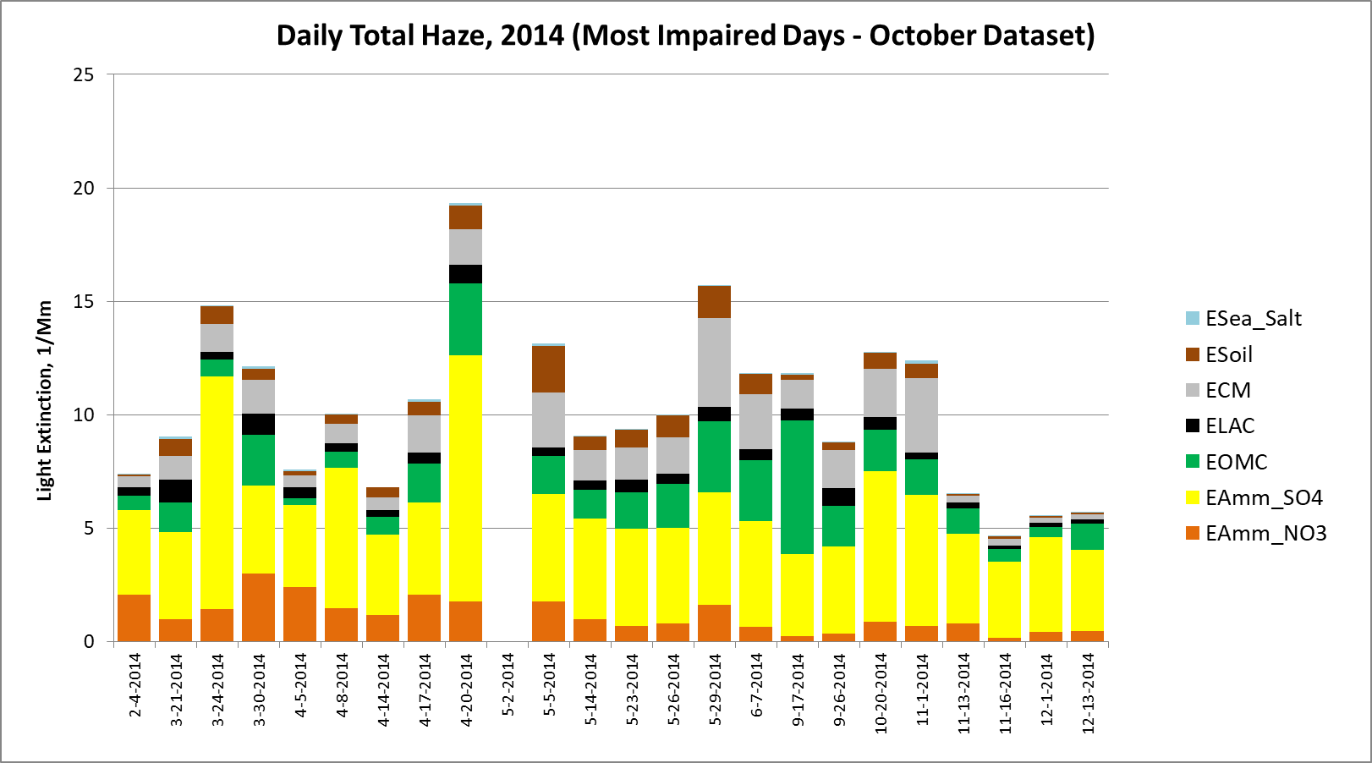
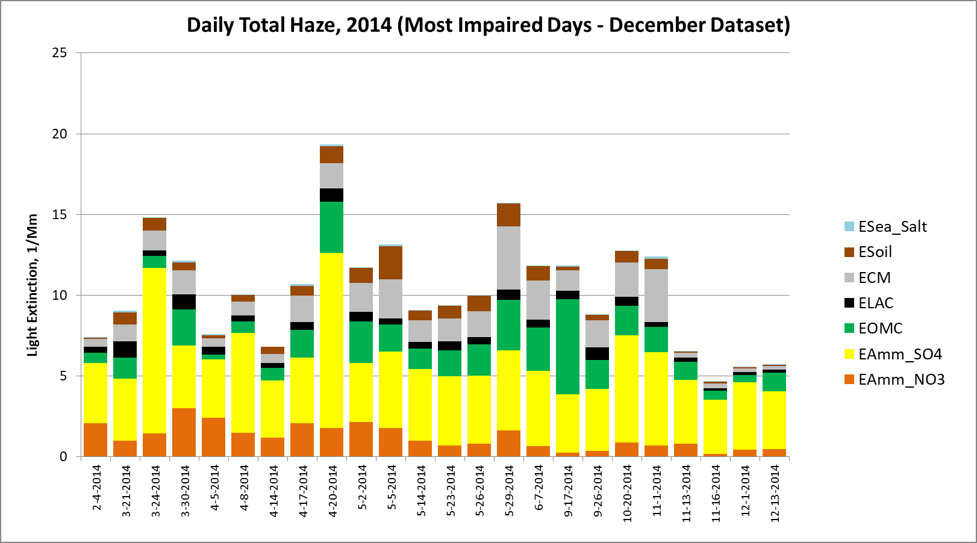
Changes in Group 90 Days - 2014
For 2014 data, 19 sites saw a change in selection of the most impaired days.
Some instances of extended patching resulted in the inclusion of an additional Group 90 day
Example: Bridger gained one day (5/2/2014)

Slide 7
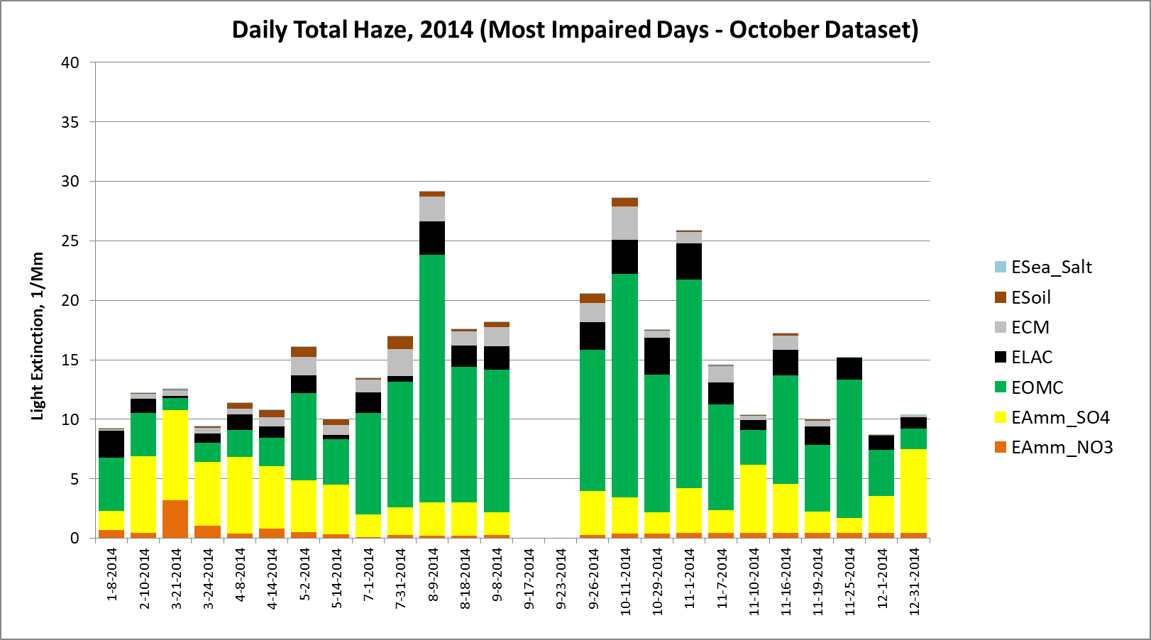
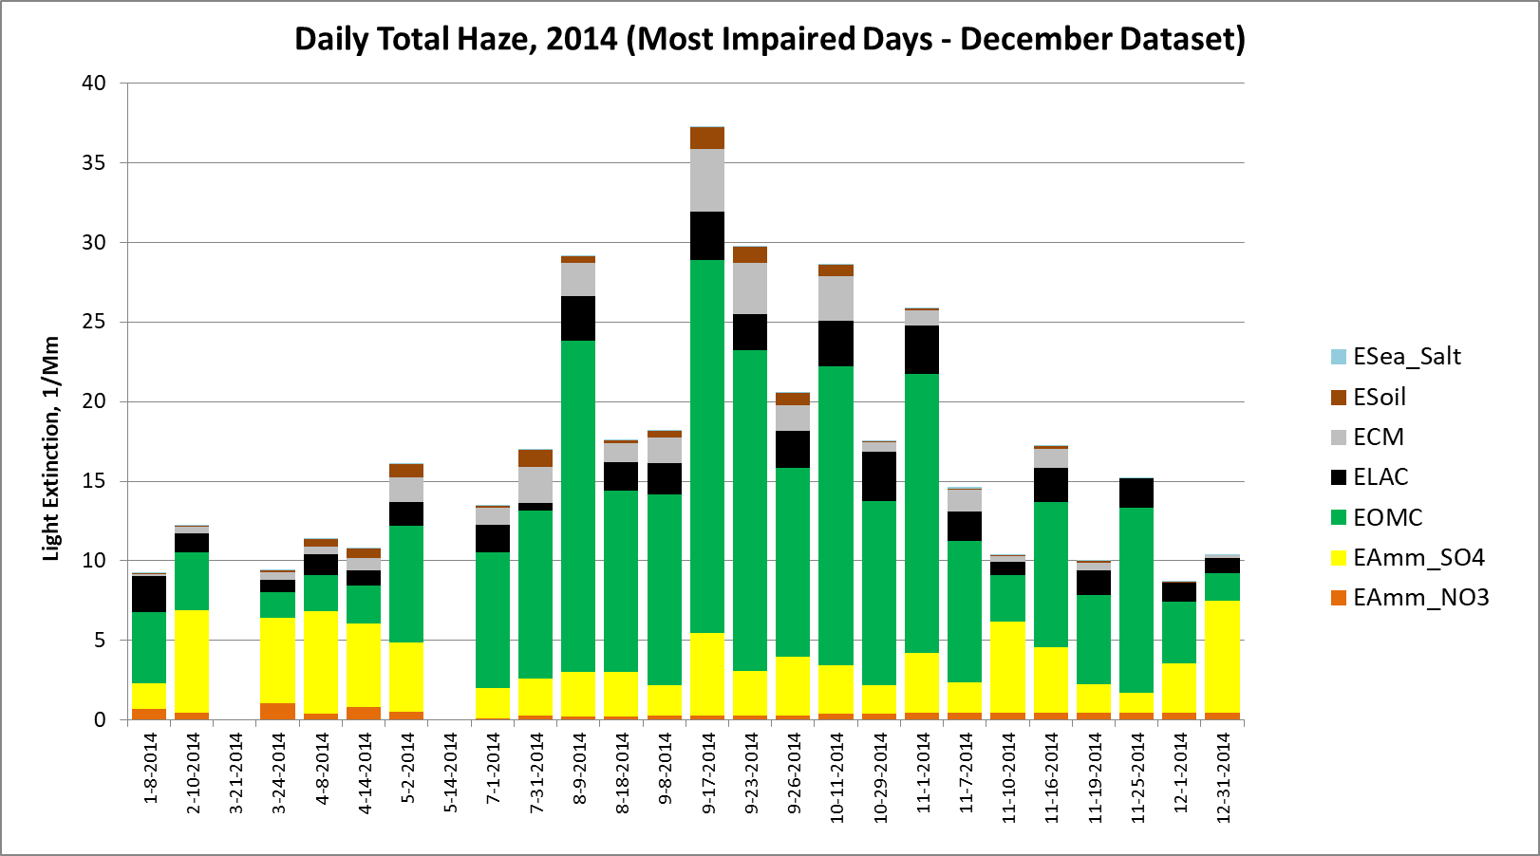
Changes in Group 90 Days - 2014
Some instances of extended patching resulted in a different set of selected days
Monture lost days in the spring and gained days in the summer
Next Steps:
  Comparison of selected most impaired days in 2016
  Clearest and all days in 2014 and 2016
  Natural Conditions

Slide 8
Identification of Days That Left or Entered Group 90 Between Oct & Dec Data Sets
The left table shows which site/dates in 2002, 2014, and 2016 moved from G90 to G70
The right table shows which site/dates moved from G70 to G90 or were days that previously were not complete but after patching fell in G90

Slide 9
Data Substitution: 2018 Data
Sites requiring substitution to complete 2018 data set
    AQTI1 (< 75% data capture for Q2, Q3, Q4)
    HOOV1 (63% data capture for Q1)
    IKBA1 (67% data capture for Q2)
    WHPE1 (< 75% data capture for Q2, Q3)
    HAVO1 and SIAN1 also not complete for 2018, but not suitable for substitution due to lack of reasonable donor site (HAVO1) or data capture of 0% (SIAN1)
Compared mass data between donor and recipient sites over the 2014-2018 5-year period
  Used Kendall-Theil statistics to compare mass data from recipient and donor sites
Continuation of data substitution work from Fall 2018 :
http://www.wrapair2.org/pdf/Memo%20-%20donor%20site%20recommendations%20for%20data%20substitutions.pdf

